Slide 1
Software Architecture & Construction
Refactoring program designs

Slide 2
Program Refactoring
Refactoring
  Program transformation that preserves semantics
  Improves software qualities
    Understandability, extensibility, reusability
Why is refactoring important?
  Keep up with software evolution
    It may be necessary to improve design to support further functionality

Slide 3
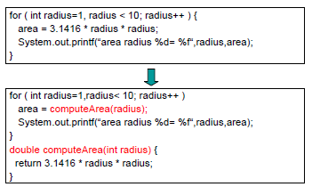
Simple Refactoring - 1
Consider this:

Slide 4
Simple Refactoring 1– so what?
What was gained?
  Understandability
    By looking at the code you can tell better what the computation is doing
Anything lost?
May be some performance
    Short loop and compilers are smart (inlining)

Slide 5

Simple Refactoring -2
Could you refactor this function?

Slide 6
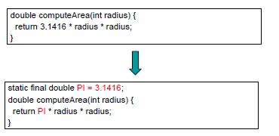
Simple refactoring 2- sample soln
Consider using static field PI:

Slide 7
Simple Refactoring 2 - reflections
So what was gained?
  Understandability
    By looking at the code you can tell better what the computation is doing
Performance
  Maybe – possible compiler optimization, specially if variable is used in several places
Anything lost?

Slide 8
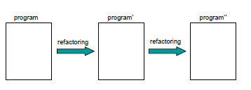
Refactoring Insights -1
Refactorings are relatively small changes
A refactoring focus on one change at a time
Several refactorings can be applied to a program incrementally

Slide 9
Refactoring Insights -2
To apply a refactoring, certain conditions should hold
  Example: There should be a magic number in a computation
Each refactoring is an algorithm that consists of several steps
  Example: Declare a static final field with a meaningful name
  Initialize the field with the magic number
  Substitute the magic number in the original computation with the new field

Slide 10
Insights - Recap
Refactorings are relatively small changes
A refactoring focus on one change at a time
Several refactorings can be applied to a program incrementally
To apply a refactoring certain conditions should hold
Each refactoring is an algorithm that consists of several steps

Slide 11
Why refactoring?
Improve design of software
Improve understandability
Bug finding
Improve programming productivity
Code faster – because all of the above

Slide 12
Refactoring – when?
You find yourself doing duplicating functionality
  Potential maintenance problem
When a new program feature is added
  Code must be changed to accommodate the new feature
Bug fixing
  Improving code to understand possible source of bug
Code review
  Special sessions where teams analyze and discuss code fragments looking for improvements or identifying problems

Slide 13
Signals Refactoring is needed
When do you know your program needs a refactoring? When to stop?
Answers
  There are no simple answers
Best approach heuristics
  Rules-of-thumb programmers develop over time (experience)
In refactoring lingo
  Code smells

Slide 14
Code smells - 1
Duplicate code
  Code doing more or less the same thing in different places
Long method
  Methods should do one and only one thing
  Ex. my heurisitic method length < 100 LOC
Large class
  Classes should model one and only one problem domain entity
  Many instance variables (doing many things at once)

Slide 15
Code Smells -2
Long Parameter List
  Harder to understand and to use properly
  Stronger dependency with the target object
  Reduce the number of parameters
Divergent Change
  Class fragments seem to be more related than other (changes or updates)
  Separate fragments into their own classes
Feature envy
  A method is more related to another class than its containing class
  Move the method to the other class

Slide 16
Code smells -3
Data clumps
  Class fields seem to appear always together
  Create a type for them
Primitive obsession
  Treat data in its primitive form
  Create primitive objects from primitive types
Switch statements
Repeated switch statements that handle just primitive types
  Try OO polymorphism

Slide 17
Code smells -4
Lazy class
  Class that it is doing too little
  Eliminate it and move the contents to another class
Speculative Generality
  Support for “future” functionality that is not being used
  Remove it
Temporary fields
  Some instances of a class use the value of a field, other instances don’t
  Find a class for these fields

Slide 18
Code smells -5
Message chains
  A method call triggers the execution of many other methods to get an answer
  Reduce the length of chain
Middle man
  A method call triggers many other calls
  Talk to the target (destination) object directly

Slide 19
Code smells -6
Inappropriate intimacy
  Classes know more private secrets from other classes than they actually need to
  Make classes more discrete
Refused bequest
  Subclasses may not need some of the fields and methods inherited from their parent
Move unwanted inherited stuff to your siblings

Slide 20
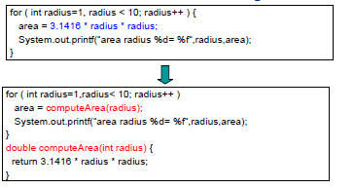
More Refactoring Examples
Extract method example

Slide 21
Extract method - mechanics
Create a new method with a meaningful name
Copy code into the target method
Analyze variable references
  Local variables that are just read become parameters
  Variables that are modified in the new method and used later should be returned as values
  Caveat: more than one variable is modified in the extracted code
Replace extracted code with method call

Slide 22
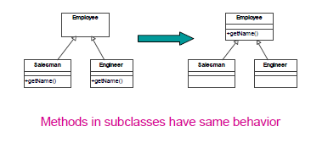
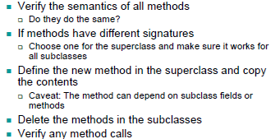
Pull up method example
Pull up mechanics

Slide 23
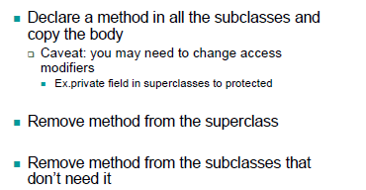
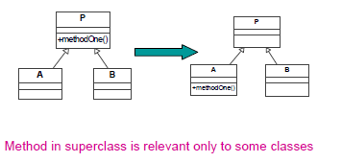
Push down method example
Mechanics

Slide 24
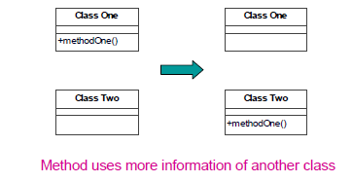
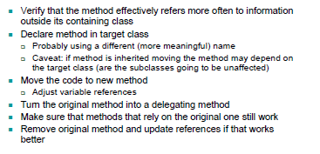
Move method example
Mechanics

Slide 25
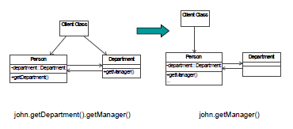
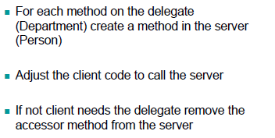
Hide Delegate
Mechanics

Slide 26
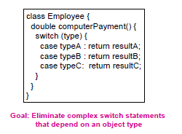
Replace conditional with polymorphism - 1

Slide 27
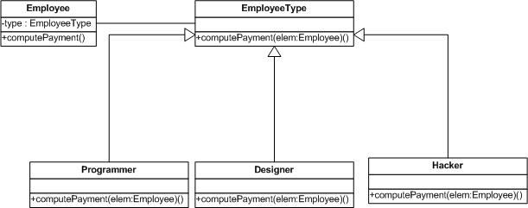
Replace conditional with polymorphism -2

Slide 28
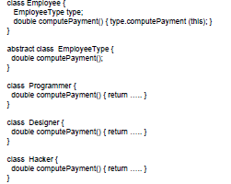
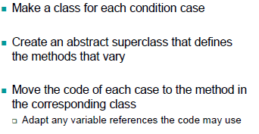
Replace conditional with polymorphism-3
Mechanics

Slide 29
Last word on Refactoring
Important that you recognize the most common refactorings by their name
More important that you understand their mechanics and rationale behind them
There are dozens of refactorings
  No need to “memorize” all of them
  Key skill is to develop an intuition to recognize opportunities for design improvement and how to implement them

